Slide 1
DIVERSITY AND DIALOGUE
IN
IMMUNITY TO HELMINTHS
BY
ABDULGANIYU, KAZEEM
180878
Cellular Parasitology Programme
SUPERVISED BY: Dr Chiaka I. Anumudu
16TH JUNE, 2015.

Slide 2
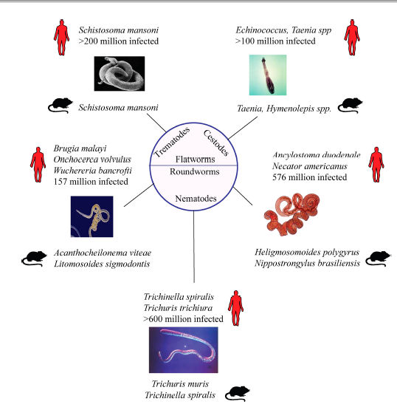
Fig1: Prevalence of Helminth infections in humans and rodents.
Source: (Maizels et al., 2009).

Slide 3
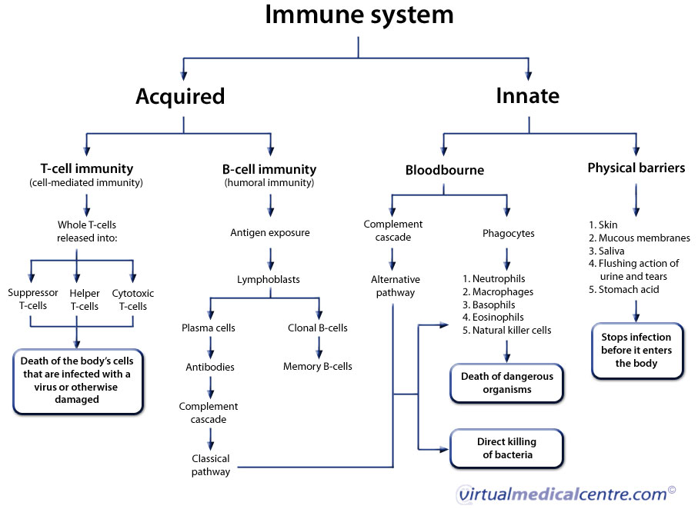
Fig 2: Schematic representation of human Immune system.
Source: www.myvmc.com/anatomy/human-immunesystem/

Slide 4
IMMUNITY TO HELMINTHS
The immune responses of the hosts to Helminth infections are generally characterized by T helper 2 Type responses (Moreau and Chauvin, 2009).
T_{H}2 response is characterized by the expression of type 2 cytokines such as Interleukin (IL-4), IL-5, IL-9 and IL-13 (Neill and McKenzie, 2009).
This immunity is generally designated as “Type 2 immunity” since it encompasses both innate and Adaptive immune players (Allen and Maizels 2011).

Slide 5
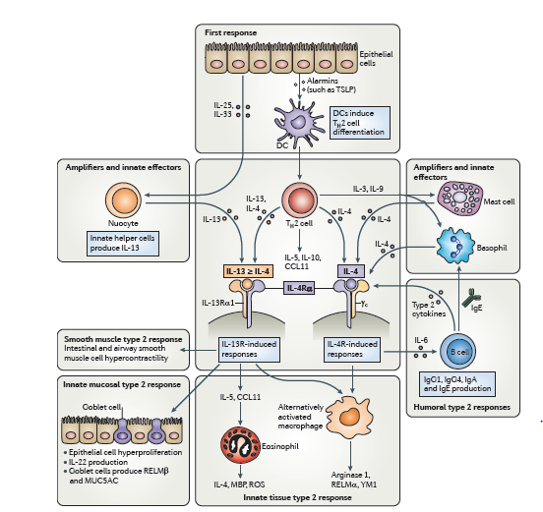
Fig 3: Components of Type 2 Immunity.
Source: (Allen and Maizel 2011).

Slide 6
Mechanisms of T_{H}2-type immunity to Helminths
Effector mechanisms of T_{H}2 immunity could occur in ;
  Mucosal tissues such as gastrointestinal tracts, respiratory tracts and urinary tracts.
  Peripheral Tissues such as skin, bloodstream and other tissue sites.

Slide 7
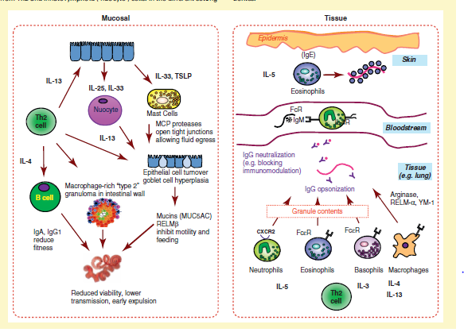
Fig 4: T_{H}2-type Effector mechanisms in immunity to Helminths in Mucosal tissues and peripheral tissues.
Source: (Taylor et al, 2012).

Slide 8
Activation of T_{H}2-Type Responses
Activation of T_{H}2 response involves a molecular dialogue between the helminths and the host immune system (Allen and Maizels, 2011).
Activation of T_{H}2 response may occur through the following routes;
    Alarmins – innate helper cells e.g. IL-25 or IL-33 or TSLP- innate cells
    Activation through modulation of Dendritic cells by Helminths or Helminth-derived molecules.

Slide 9
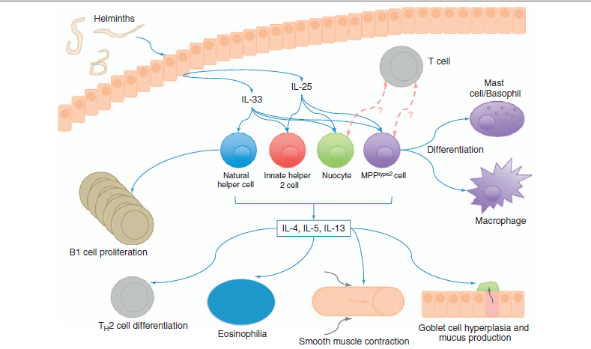
Fig 5: Activation of T_{H}2 responses through Alarmins-innate lymphoid cells interaction.
Source: (Neill and Mckenzie, 2011).

Slide 10
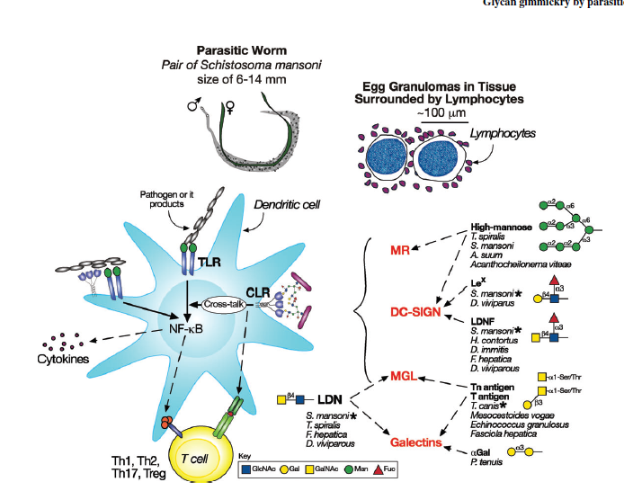
Fig 6: Dendritic cells capture Helminth products through receptors and control T cell responses.
Source: (Van Die and Cummings, 2010) .
1

Slide 11
Diversity in type 2 Immunity
Effective interactions between helminth and immune system drives the diversification of key immunological functions in type 2 immunity (Allen and Maizels, 2011).
This diversity could be:
  Context-specific Diversity: e.g. Thymic Stromal Lymphopoietin (TSLP)
  Cell- specific Diversity: molecules produced by different cells perform different functions. e.g. Resistin Like Molecule α/β (RELM α/β).

Slide 12
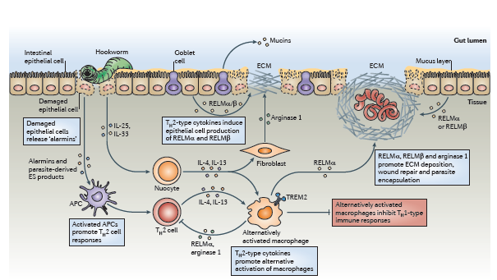
Fig 7: Cell-specific diversity in Type 2 immunity
Source: (Allen and Maizels 2011).

Slide 13
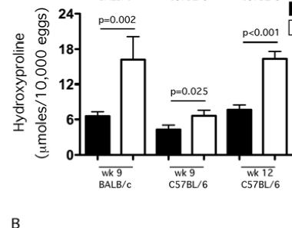
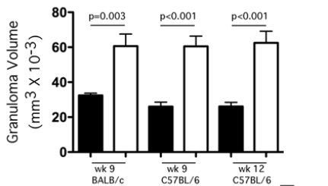
Fig 8: Effect of Arginase-1 expressing macrophages on T_{H}2 driven Fibrosis and inflammation.
Source: (Pesce et al., 2009).

Slide 14
SIGNIFICANCE OF DIALOGUE IN
TYPE 2 IMMUNITY
Maintenance of Homeostasis
Repair of Helminth-induced damage
Prevention of Allergic and autoimmune diseases

Slide 15
Maintenance of Homeostasis
Effective dialogue between helminth and immune system helps in the maintenance of homeostasis through;
Inflammatory control
Wound repair
Helminth resistance

Slide 16
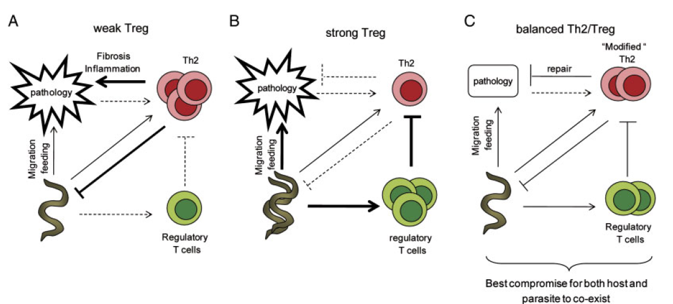
Fig 9: Balance between T_{H}2 and regulatory T cells (Treg) responses help to maintain homeostasis through inflammatory control.
Source: (Everts et al., 2010).

Slide 17
Repair of Helminth-induced damage
Fig 10: Immunological dialogue in the repair of tissue damage. Source: (Allen and Maizels, 2011).

Slide 18
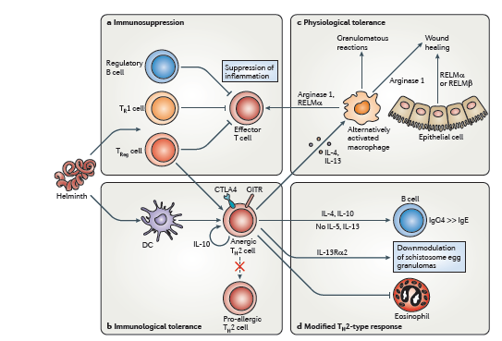
Fig 11: Ways by which immune-Helminth interactions help to maintain homeostasis within the host.
Source: (Allen and Maizels 2010).

Slide 19
Prevention of Allergic and Autoimmune Disorders
Interaction between helminth and immune system helps to prevent the following diseases in the host.
Allergic diseases e.g. Asthma, rhinitis etc.
Multiple Sclerosis (MS)
Type I Diabetes (T1D)
Inflammatory Bowel Disease (IBD)
Rheumatoid Arthritis (RA)

Slide 20
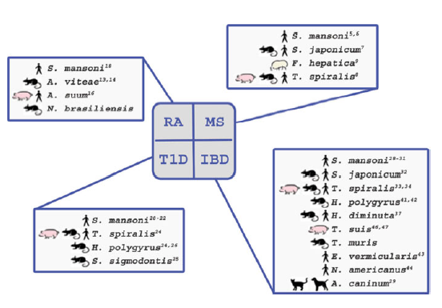
Fig 12: Helminth species that have been reported to ameliorate the different autoimmune disorders.
Source: (Kuijk and Van Die, 2010).

Slide 21
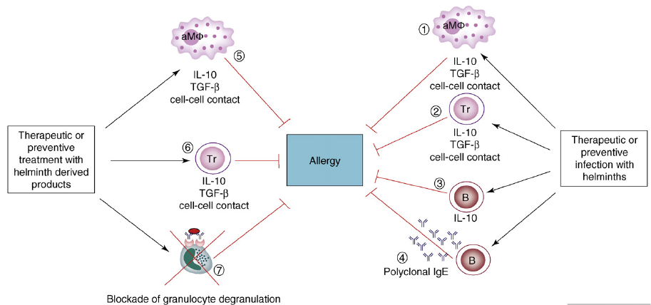
Fig13: Possible mechanisms for Inhibition of Allergic responses by Helminths (Erb, 2009).

Slide 22
Table 2: Correlation between Helminth and Allergies
Study Country | Population (Age range) | Helminth | Outcome | References
Gabon | 520 children (5-14 yrs) | Schistosoma mansoni | Reduced skin reactivity to mite | Van den Biggelaar et al (2000, 2001)
Brazil | 175 subjects | Schistosoma mansoni | Reduced skin response to aeroallergens | Araujo et al (2000).
Ethiopia | 604 Adults (˃16) | Hookworm | Reduced risk of wheezing | Scrivener et al.(2001).
Uganda | 62 infants | Filaria and Hookworm (Maternal Helminthiasis) | Protection against infantile eczema | Elliot et al.(2005).
Ethiopia | 563 children (1-4 years) | Ascaris lumbricoides, Hookworm | Reduced Wheezing | Dagoye et al. (2003).
Nigeria | 209 Adults | Intestinal Helminths | Promotion of inflammatory responses in Asthma patients | Arinola et al. 2014

Slide 23
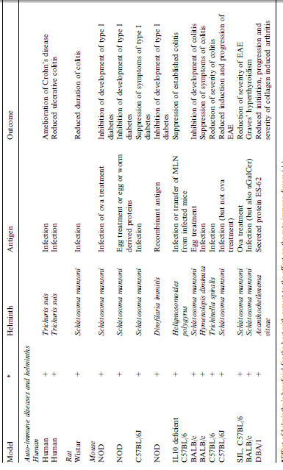
Table 3: Correlation between Helminth and auto-immune diseases
(van Riet et al. 2007)

Slide 24
CONCLUSION
Helminths are multicellular worm-like organisms of which many species are parasitic.
Helminth infections are characterized by polarizing towards a T helper 2 type response as well as regulatory responses.
Effective dialogue between the helminths and the host immune system have been observed to drive the diversification of key immunological functions that enable the helminths to survive for many years and prevent the host from allergic and autoimmune diseases.

Slide 25
THANK YOU
FOR
LISTENING

