Slide 1


AN INTRODUCTION TO OPEN SCIENCE
Inguyesi Christine Nereya,
Local Network Lead, African Reproducibility Network (AREN)
12th November, 2024
VETERINARY SCIENCE RESEARCH INSTITUTE

Slide 2
OUTLINE
What is Open Science
Why Open Science Matters
Open Science Barriers and Challenges
Overcoming Challenges
The Open Science Landscape

Slide 3
What is Open Science?
Open Science is the practice of making scientific research, data, and
dissemination accessible to the public, policymakers, practitioners,
or professionals.
This approach encourages:
Transparency
Reproducibility
Broad collaboration in the research process.
Open Science is about removing barriers to knowledge and making science a public good

Slide 4
Drivers of the Shift Towards Open Science
Difficult accessibility to scientific literature
Costly subscription-based publishing and paywalls lock up knowledge
Reproducibility crisis
• Concerns over the ability to replicate the results of existing studies affected trust in scientific research.
Biases in scholarly review and publications
• Traditional peer review, has been criticized for its potential for bias, lack of transparency, and sometimes hindering innovative research.
Lack of collaboration and inter-disciplinarity in research
• Research is often operated within disciplinary and geographical silos, limiting the exchange of ideas and methodologies.

Slide 5
Addressing Key Challenges in Science through Open Practices
Open science has emerged as a transformative approach to address
several critical issues facing the scientific community today.
It does so by fostering a collective agreement on employing:
Principles
Values
Pillars
Framework for Community and Collaboration.

Slide 6
Open Science values
Equity- Ensuring equal access to scientific knowledge and opportunities for contribution.
Integrity- Upholding high standards of honesty and transparency in conducting and reporting research.
Collective benefit- Viewing knowledge as a collective asset that should benefit society as a whole.

Slide 7
Open Science Principles
Transparency- Making the research process openly available at all stages.
Accessibility- Ensuring that scientific outputs are accessible to all, removing financial, technical, or legal barriers.
Reproducibility- Facilitating the verification of results through shared data and methodologies.
Collaboration- Encouraging cooperative work across disciplinary and geographical boundaries.
Inclusivity- Promoting diversity and participation in science by all sectors of society.

Slide 8
Open Science Pillars
Open Knowledge Dissemination
  Preprints: complete but unpublished research papers shared publicly before undergoing peer review.
  Open Access: Making research publications freely available.
  Open Educational Resources: Providing free access to educational content.
Open Research Processes
  Open Data: Sharing raw research data for transparency and reusability.
  • Open Methodology: Disclosing research methods and protocols for reproducibility.
  • Open Notebooks: Keeping research logs and lab books publicly accessible throughout the research process.
  • Open Peer Review: Enhancing transparency and inclusivity in the review process.

Slide 9
Open Science Pillars continued
Community Engagement and Collaboration
  Citizen Science: Involving the public in scientific research to expand participation.
  Open Educational Practices: Encouraging teaching and learning practices that embrace openness.
  Open Advocacy: Promoting the values and benefits of open science within the scientific community and to the wider public.
Open Tools and Infrastructure
  Open Source: Promoting the use of open-source software in research.
  Open Hardware: Promoting the design and production of physical devices, tools, and electronics in an open and transparent manner.
  Open Infrastructure: Supporting open platforms, tools, and services essential for conducting and disseminating open science.

Slide 10
QUESTIONS?

Slide 11
Key Benefits of Open Science
Improves Research Efficiency-  Access +  cost
2. Improves Research Quality-  Transparency +  Reproducibility
3.Accelerated Discovery and Innovation-Dissemination +  Application
4.Fosters Collaboration and Global Participation-  Barriers +  Inclusivity

Slide 12
Barriers & Challenges of Open Science
Have you encountered any challenges in line with Open Science?

Slide 13
Barriers & Challenges of Open Science continued
Lack of Awareness and Training
Insufficient local or regional open science communities or networks
Inadequate policies or support from funding agencies
Economic constraints limiting access to open science platforms
Lack of infrastructure or tools
Concerns about intellectual property or competition
Institutional or cultural resistance
Access to internet and or electricity
Legal and ethical issues
Language barriers

Slide 14
Overcoming Challenges: Multifaceted Approach
1. Promoting awareness and education
  • Training and workshops
  • Incorporate Open Science in curricula
2. Establish and strengthen networks
  • Create local Open Science groups
  • Form regional consortia
3. Foster collaboration and partnerships
  • Partner with OS international networks
  • Participate in Global OS Events
4. Invest in infrastructure and technical support
  • Invest in open infrastructure (e.g.Repositories)

Slide 15
Overcoming Challenges: Multifaceted Approach
5. Establish financial models and policies
  • Explore sustainable funding models
  • Encourage formation and adoption of institutional OS Policies
7. Create cultural change and incentivization
  • Identify and support OS champions
  • Highlight OS success stories
  • Rewarding OS practices
6. Create legal and ethical frameworks
  • Develop guidelines and tools to help researchers navigate ethical issues
8. Promote inclusivity and equity
  • Develop and disseminate open science resources in local languages
  • Support underrepresented groups

Slide 16
The Global Open Science Landscape
• The global landscape of OS is characterized by a rapidly evolving
framework of policies, initiatives, and technologies designed to
make scientific research more accessible, transparent, and
collaborative.
• This is shaped by contributions from a wide range of stakeholders, including governments, funding agencies, research institutions, libraries, publishers, and the research community at large.

Slide 17
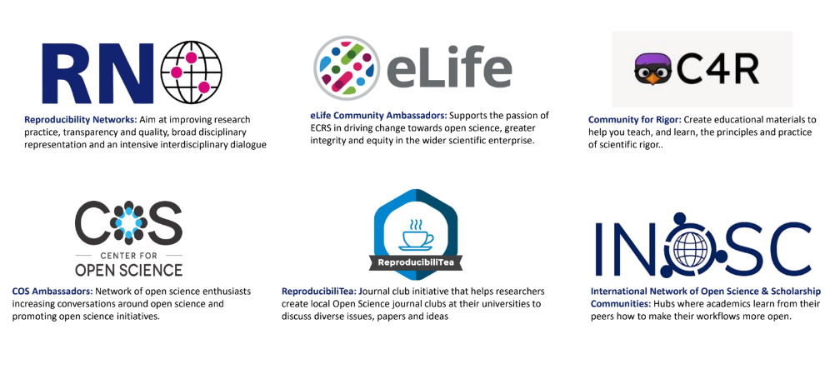
The Global Open Science Landscape: Communities for Researchers
eLife
C4R
COS
Reproducibilitea
INOSC

Slide 18
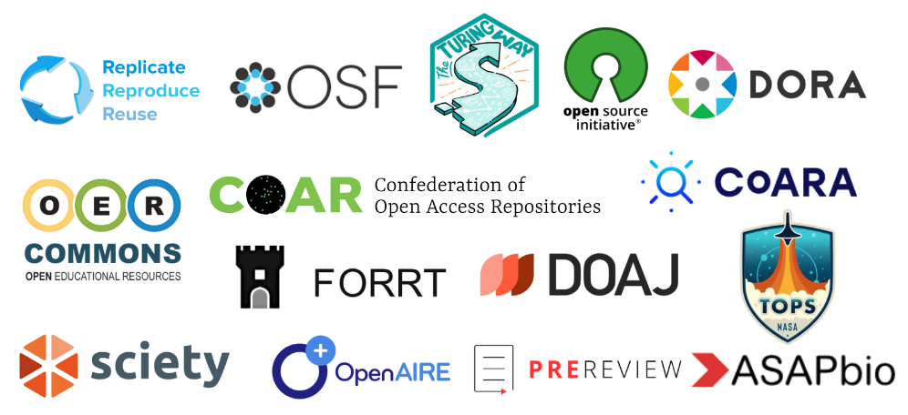
The Global Open Science Landscape: Resources and Toolkits

Slide 19
The African Open Science Landscape
• The OS landscape in Africa is characterized by growing momentum and diverse initiatives aimed at promoting accessibility, transparency, and collaboration in scientific research.
• The landscape reflects both the unique challenges, and the dynamic opportunities present across the continent.

Slide 20

The African Open Science Landscape: policies
National OS roadmaps being worked on in Côte d’Ivoire, Ethiopia, Ghana, Lesotho, Mozambique, Nigeria, Somalia, Tanzania and Uganda
(LIBSENSE)

Slide 21
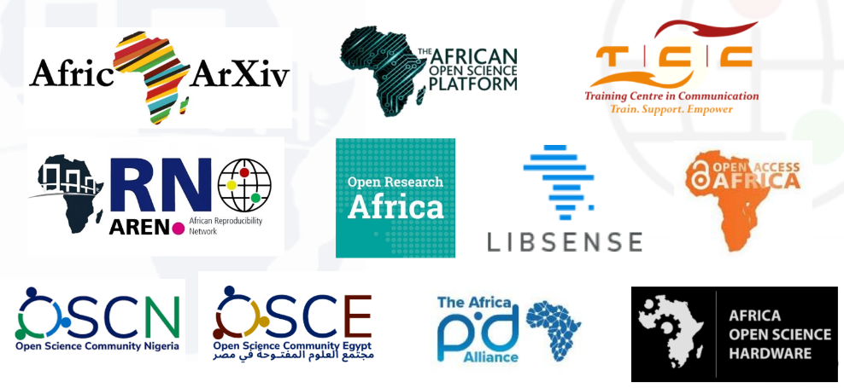
The African Open Science Landscape: Initiatives

Slide 22
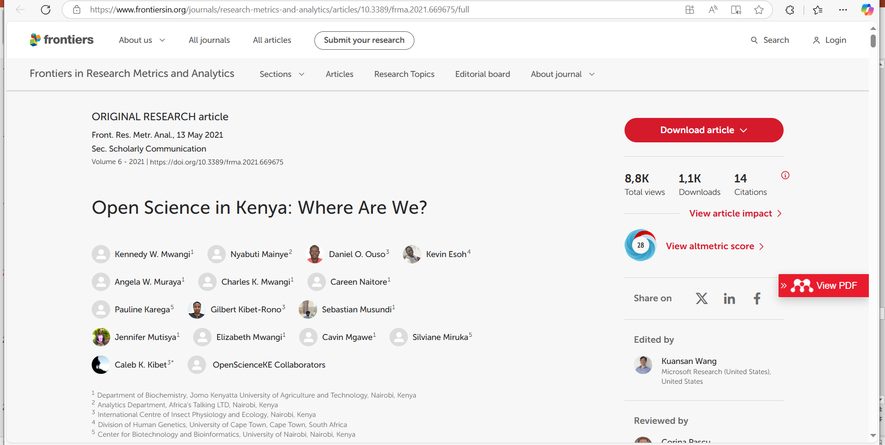
Open Science in Kenya: Where are we?

Slide 23
Open Science in Kenya where are we?
Methods snippet
1. Does the institution have an institutional repository?
2. Does the institution have any open science policy?
3. Does the institution conduct any open science events or training?
4. Does the institution have an open educational resource?
Findings
ILRI has a research data management policy and an open access policy.
The UoN has an open access policy - University's open repository
JKUAT has an open research data policy that promotes high research data management standards for reproducibility and sharing.
JKUAT, UoN, ILRI, and KU had held open science training events
Resources to Support Open Science Are Insufficient, but Growing
Need to harness e-infrastructure- ICT
Open Educational Resource

Slide 24
Open Science in Kenya where are we? Continued
Digital research repositories in Africa showed that Kenya had 32% of repositories in Africa and was preceded by South Africa, which had 40%
Adoption of Open Access Publishing by Kenyan Authors (https://github.com/BioinfoNet/LowCostOpenAccess
Adoption of Preprints by Kenyan Authors
Overall, based on the 2018 data from the BioRXiv preprint server, Kenya is leading Africa in preprint publications

Slide 25
Discussion: The Future of Open Science in Kenya
Envision the future landscape of open science in Kenya.
• What key steps need to be taken to realise this vision?

Slide 26
Q&A

