Slide 1
IMPACT OF FREE HEALTH CARE ON MORTALITY REDUCTION AND MODELING ITS EFFECT ON UNDER-FIVE CHILDREN IN MOYAMBA DISTRICT, SIERRA LEONE
PhD VIVA VOCE
BY
BRIMA GEGBE
DEPARTMENT OF MATHEMATICS & STATISTICS, NJALA UNIVERSITY
SUPERVISORS:
PROF. H. KANDEH & PROF. A. BAIMBA

Slide 2
1. Introduction
1.1. Background
An efficient, affordable and equitable health care system is critical for breaking up vicious circle of poverty, ill health and untimely death.
UN Millennium Declaration in Sept. 2000 committed nation states to a new global partnership to combat extreme poverty, address health challenges and support development interventions.
Among the Millennium Development Goals (MDGs) was a commitment to reduce child mortality by two-thirds between 1990 ̵ 2015 (MDG, 2000).
Despite this, some 9 million children have died before age 5, largely from preventable causes (UNICEF, 2008).

Slide 3
1.1. Background Cont.
  For many years, Sierra Leone has held the unenviable last place in the UN Human Development Index (HDI) because of its alarming health indicators.
  The poor ranking was as a result of its under-five mortality rate, with 194 child deaths per 1,000 live births(Water, 2013).
  This suggested that Sierra Leone was off track towards meeting the MDG 4 (reducing child mortality) and MDG 5 (improving maternal mortality).
  In order to tackle the high mortality rates and accelerate efforts towards achieving the health-related MDGs, FHCI was launched in April 2010.

Slide 4
1.1. Background Cont.
  FHCI aim was to ensure increased availability and utilization of quality healthcare services for pregnant and lactating women and under-five children in the country.
  Despite improvements, data show that maternal and U5MR remain unacceptably high, due largely to inadequate health care services and difficulties in accessing and utilising services.
  Patients entitled to free healthcare under FHCI persistently complained about being charged by healthcare workers or sent to private pharmacies to buy drugs (Amnesty, 2011).
  With these huge challenges confronting FHCI, there was the need to investigate the impact of the initiative on under-five mortality reduction after ten years of implementation

Slide 5
1.2. Research Questions
  What are the effects of FHCI on under-five children in Moyamba District?
  What are the effects of FHCI on health services utilization in Moyamba District?
  What are the potential impacts of scaling up FHCI intervention via use of Life Saving Tools (LiSTs)?
  How appropriate are Generalized Linear Models (GLMs) for testing if health deployment in a chiefdom is driven by the type of health facilities/professionals in the district

Slide 6
1.3. Aim of Study
  Assess the impact of FHCI on mortality reduction modelling its effect on under-five children in Moyamba District.
1.4. Specific Objectives
  To assess planed and monitor scaled up interventions that are key to achieving UN Sustainable Development Goals (SDGs) in Moyamba District.

Slide 7
1.4. Specific Objectives Cont.
  To evaluate the effects of healthcare services utilisation on under-five children in the district.
  To use LiSTs to estimate potential impacts of scaling up healthcare interventions.
  To use GLMs to test if health worker deployment in a chiefdom is driven by health facility/professional type in district

Slide 8
2. Literature Review
  The introduction of user fee systems in the government health facilities in most Sub-Saharan African (SSA) countries shifted part of the burden of financing healthcare to communities, raising concerns about its relation to health outcome of infants and children.
  The levy of user-fees to finance health facilities operated by governments has been moderately successful in 37 countries (Griffen, 1998) and hardly enforced in another 11 countries in SSA.
  As concluded, user fee disproportionately increases the barriers faced by all poor seeking healthcare.

Slide 9
2. Literature Review Cont.
  In Sierra Leone, user fees is a relatively small element considered negligible for running an effectively national health system.
  Besides, the country has the highest under-five mortality rate (267 deaths per 1000 lives birth ), even higher than that of Sao Tome (62 deaths per 1000 lives birth ) where there is no user fee(UNICEF, 2005).
  This is believed to implying that health services are cut off from all who cannot afford to pay.

Slide 10
2. Literature Review Cont.
  The experience of fee removal in Uganda, in 2001, observed an increase in outpatient utilization, the poor benefited the most (Nabyonga et al., 2005).
  A year after the fee removal in Sierra Leone, reflected a 150 per cent improvement in maternal complications managed at health facilities and medical care for under five children increased by 214 per cent (FHCR,2011)
  Most often, for fee removal or FHCP increased in utilization is observed, fully in line with basic economic theory (law of demand).

Slide 11
2. Literature Review Cont.
  However, for many observers, the real challenges lie elsewhere.
  The implementations of user fee together with non user fee health initiatives have different challenges and the countries specifics are therefore driven by the policies with the most benefit to the people.
  The force behind the implementation of the existing health policies was the object of this research. To study the impact of FHCI on mortality reduction and modelling its effect on under-five children in Moyamba District.

Slide 12
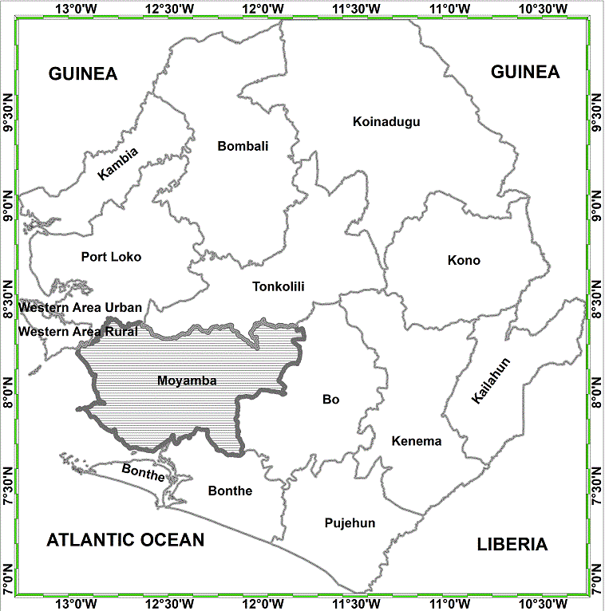
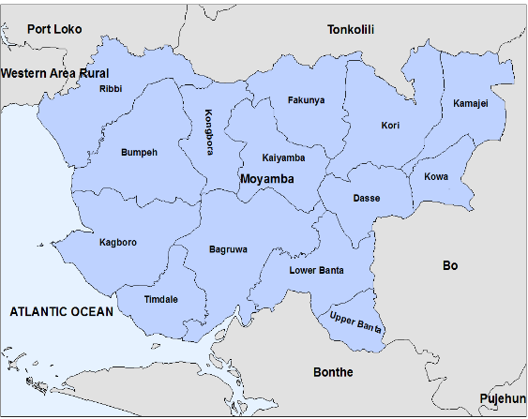
3. Research Methodology
3.1. Study Area
Figure 1: A map of Moyamba District depicting the chiefdoms in the district in Sierra Leone (Field Survey)

Slide 13
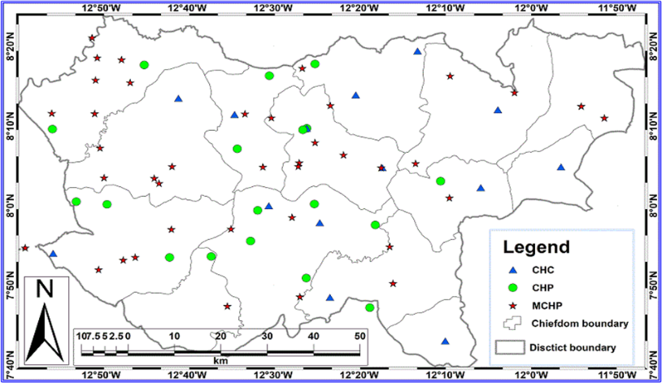
3.2 Distribution of healthcare facilities
Figure2: Distribution of healthcare facilities in Moyamba district, southern Sierra Leone. Source: Field Survey

Slide 14
3.2. Sample Design and Instruments
The selection of representative sample was done by :
  Determination of eligible facilities;
  Construction of a list frame;
  Determination of domains and/or strata;
  Determination of sample size; and
  Selection of samples from the list.
3.3. Sampling Frame
Probability sampling was used to select the facilities for inclusion in the study. Stratified sampling was done to ensure fair representation across various domains of eligible facilities.

Slide 15
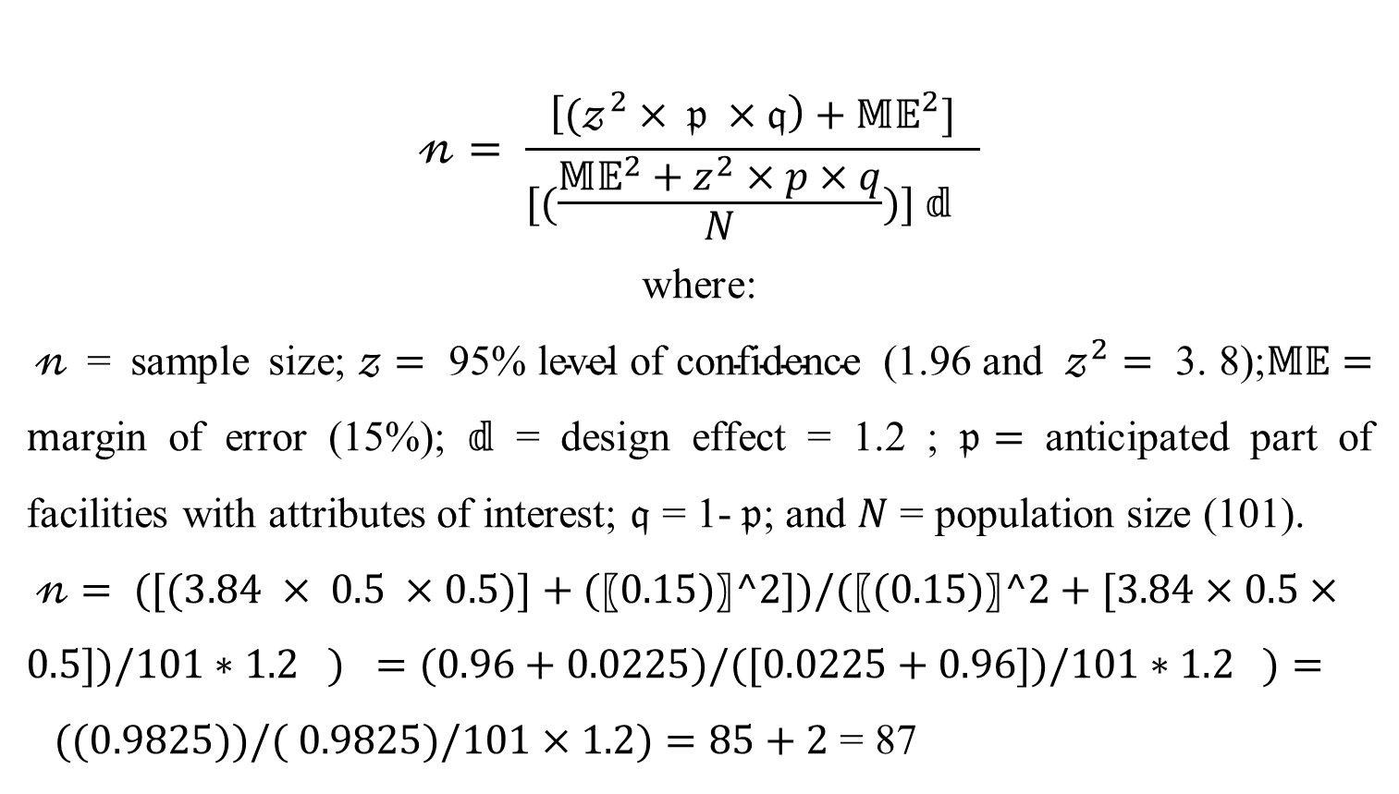
3.4. Sample Size
$$𝓃= \frac{\left[{(𝓏}^{2} × 𝔭 ×𝔮\right)+{𝕄𝔼}^{2}]}{[(\frac{{{𝕄𝔼}^{2}+z}^{2}×p×q}{N})] 𝕕 }$$
where:
$𝓃$ = sample size;$𝓏=\text{ 95\% }\text{level} \text{of} \text{confidence}\text{ (1.96 }\text{and} 𝓏^{2}=\text{ 3. 8);}𝕄𝔼=m$argin of error (15%); $𝕕$ = design effect = 1.2 ; $𝔭=$ anticipated part of facilities with attributes of interest; $𝔮$ = 1-$𝔭$; and $N$ = population size (101).
$𝓃= ([(3.84 × 0.5 ×0.5)]+(〖0.15)〗^2])/(〖(0.15)〗^2+[3.84×0.5×0.5])/101∗1.2 ) =(0.96+0.0225)/([0.0225+0.96])/101∗1.2 )= ((0.9825))/( 0.9825)/101×1.2)=85+2$ = 87

Slide 16
3.4. Data Type
  Both primary and secondary data were used in the analysis.Stat Graphic and SPSS where used for data analysis
3.5.Mathematical Model
  LiST, version 4.53(Johns Hopkins Bloomberg School of Public Health, Baltimore, United States of America — available at: (http://www.jhsph.edu/departments/international-health/centers-and-institutes/institute-for-international-programs/list/index.html) to assess the impact of FHCI

Slide 17
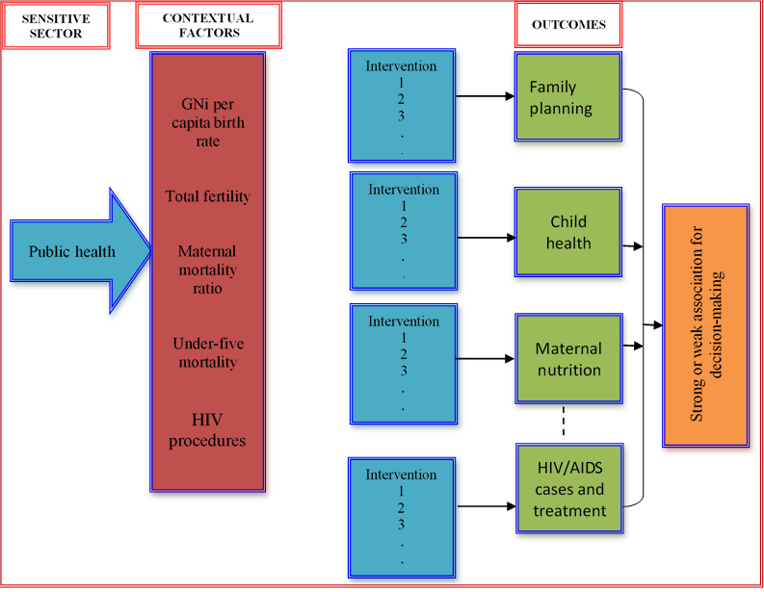
3.6. LiST Framework
Figure 2: Theoretical Framework of the LiST Model used in the study of FHCI on under-five mortality in Sierra Leone

Slide 18
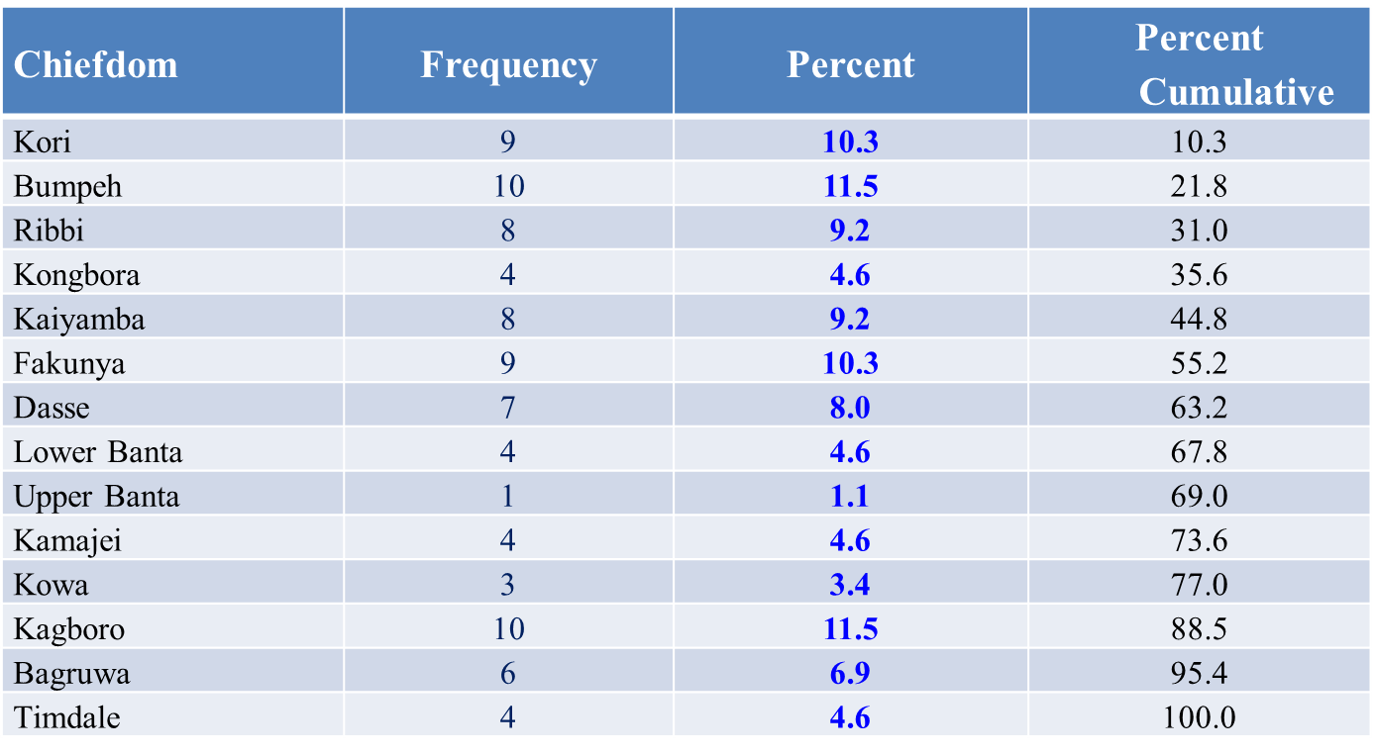
4. Results and Discussions
4.1. QUESTIONNAIRE DISTRIBUTION
Table 4.1: Distribution of questionnaires administered per chiefdom and healthcare facility

Slide 19
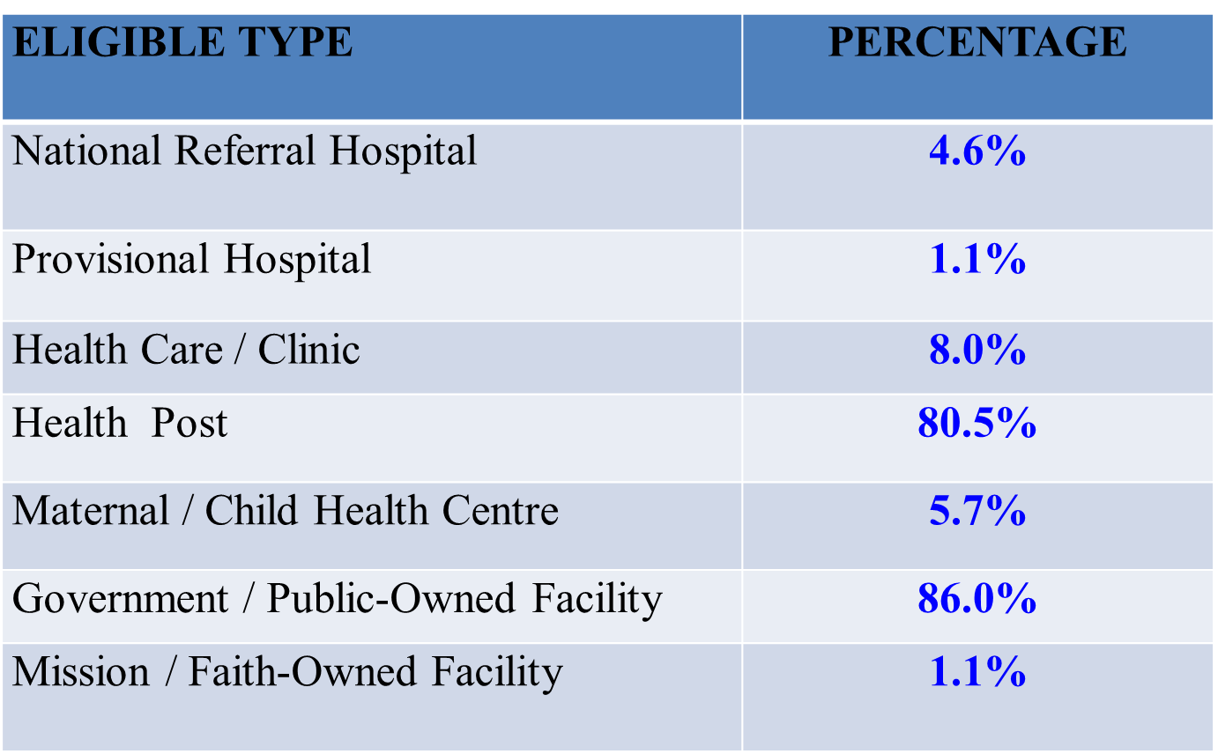
Table 4.2: Percent distribution of eligible facility type in the study

Slide 20
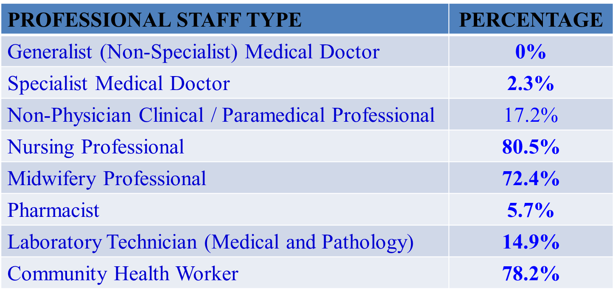
Table 4.3: Percent distribution of staff per healthcare facility in the study area
  94.3% had no pharmacists.
  85.1% had no laboratory technicians (medical & pathology).
  97.7% had no specialist medical doctors

Slide 21
4.2. Percent Availability of Health Facilities in Moyamba District
Figure 4.1: Plot of percent availability of basic amenities at healthcare facilities in Moyamba district, Sierra Leone. Note: ELEC = electricity; IMWS = improved water supply; AUVR = audio-visual room; ADSA = adequate sanitation; COEQ = communication equipment; COIN = computer with internet; EMTR = emergency treatment; ALAM = all amenities; RESC = readiness score. Source: Field survey data in this study (2019).

Slide 22
4.2 Cont.
Figure 4.2: Plot of percent healthcare faculties district with family planning services in Moyamba, Sierra Leone. Note: COCP = combined oral contraceptive pills; POCP = progestin-only contraceptive pills; COIC = combined injectable contraceptives; POIC = progestin-only injectable contraceptives; MACO = male condoms; FECO = female condoms; INCD = intrauterine contraceptive device; IMPL = implant; CBSD = cycle bead standard days method; EMCP = emergency contraceptive pills; MAST = male sterilization; FEST = male sterilization; AFPE = all family planning elements; RESC = readiness score. Source: Field survey data in this study (2019).

Slide 23
4.2 Cont.
Figure 4.3: Plot of percent diagnostic capacity of healthcare facilities in Moyamba district, Sierra Leone. Note: HEEM = haemoglobin; BLGL = blood glucose; MALA = malaria; URDP = urine dipstick protein; URDG = urine dipstick glucose; HIV = human immune-deficiency virus; SYPH = syphilis rtk; URPT = urine pregnancy test; ALDC = all monitored diagnostic capacity; RESC = readiness score. Source: Field survey data in this study (2019).

Slide 24
4.2 Cont.
Figure 4.4: Plot of percent healthcare facilities with preventive and curative care services for children in Moyamba district, Sierra Leone. Note: U5PC = under-five preventive and curative care; MADT = malnutrition diagnosis and treatment; VIAS = vitamin-A supplement; IRSU = iron supplement; ORZS = iron and zinc supplement; GRMO = Growth monitoring; PNTR = pneumonia treatment; PNTA = pneumonia treatment with amoxicillin; MATR = malaria treatment; APCC = all preventive and curative care; RESC = readiness score. Source: Field survey data in this study (2019).

Slide 25
4.3. General Service Readiness Index
(GSRI) = 55%
Figure 4.5: Plot of General Service Index at healthcare facilities in Moyamba district, Sierra Leone. Note: PRCC = preventive and curative care; ANCS = antenatal care services; MALA = malaria treatment services; PMCT = preventive mother-child transmissions; SPIP = standard precautions for infection prevention; BASU = basic surgery; CHRI = child healthcare and routine immunisation; ADHE = adolescent healthcare; BAOC = basic obstetric care; BAEQ = basic equipment; FAPL = family planning; INDM = infectious disease medicine; BAAM = basic amenities; LISC = life-saving materials; PCHM = priority child healthcare medicine; COOC = comprehensive obstetric care; DICA = diagnostic capacity; PRHM = priority reproductive health medicine for mothers; ESME = essential medicine; TUBE = tuberculosis treatment; HAAP = HIV/AIDS antiretroviral prescription client management; NCDM = non-communicable disease management; LACA = laboratory capacity; HLDE = high-level diagnostic equipment. Source: Field survey data in this study (2019).

Slide 26
4.4. Service-Specific and Specific- Service Readiness
Figure 4.6:Plot of percent capacity of healthcare facilities for monitored service-specific elements in Moyamba district, Sierra Leone. Note: FAPL = family planning; ROCI = routine child immunization; MATR = malaria treatment; TUTR = tuberculosis treatment; AVPM = antiterror viral prescription and management; SETI = sexually transmitted infection; CHRS = chronic respiratory disease; CECS = cervical cancer screening; BASS = basic surgical service; FABS = facility-based service; HIAS = HIV/AIDS service; CAVS = cardio-vascular service; and BACS = basic comprehensive surgery. Source: Field survey data in this study (2019).

Slide 27
4.5. Demographic Characteristics
4.5.1 U-5 POPULATION
Fig 4.8: Plot of under five population in Moyamba district

Slide 28
4.5.2 BIRTHS & DEATHS
Fig 4.9: Plot of Child birth and Death rates in Moyamba district

Slide 29
4.5.3 Births & Deaths Cont.
Fig 4.10: Plot of U5 Mortality and Infant mortality rates in Moyamba district

Slide 30
4.5.4 Births & deaths Cont.
Figure 4.12: Plot of percent death of children of 0–59 months aggregated by cause in Moyamba district, Sierra Leone. Note: MEAS = measles; MALA = malaria; OTHE = others; PNEU = pneumonia; NEPR = neonatal prematurity; NEAS = neonatal asphyxia; DIAR = diarrhoea; NESE = neonatal sepsis; INJU = injury; NEOT = neonatal others; NEPN = neonatal pneumonia; NECA = neonatal congenital anomalies; MENI = meningitis; AIDS = AIDS; PERT = pertussis; NETE = neonatal tetanus; NEDI = neonatal diarrhoea; and then CDBC = child death by cause. Source: Field survey data in this study (2019).

Slide 31
4.7. Impact of FHCI
Fig 4.13: Plot of Averted Anaemia of Reproductive and Pregnant Women

Slide 32
4.7.1 Impact Cont.
Figure 4.15: Plot of percent iron deficiency cases averted in pregnant and reproductive women in Moyamba district, Sierra Leone. Source: Field survey data in this study (2019).

Slide 33
4.7.2 Impact Cont.
Figure 4.17 Plot of percent maternal life saved under the free health care initiative in Moyamba district, Sierra Leone. Source: Field survey data in this study (2019).

Slide 34
4.8 Data Comparison
Figure 4.18: Plot of comparison of data on percent readiness of healthcare facilities in this study and that collected in other studies in Moyamba district, Sierra Leone. Source: Field survey data in this study (2019).Note CHIS= child immunization services; BASS= basic surgical services; PCCU= Preventive and curative care for under-five children; DITM= Diagnosis or treatment of malaria; ANSE= antennal services; TSAS=Trained staff in adolescent sexual and reproductive health services; OBSF=Obstetric signal functions;CEOC= Comprehensive emergency obstetric care;FPSE= family planning services; DICA=Diagnostic capacity; CASE=caesarean section HCSS=HIV care and support services; TBSE= tuberculosis services;APTF= arv prescription or treatment follow-up services; BLTS= blood transfusion services

Slide 35
4.8.1 Data Comparison Cont.
Figure 4.19: Plot of comparison of under-five mortality data collected in this study and that collected in other studies at national level, Sierra Leone. Note that the vertical live is the boundary between field survey data period (2010–2019) and model-projected period (2020–2024). Source: Field survey data in this study (2019

Slide 36
4.8.1 Summary
  General service readiness score was 55%
  Family planning services (FAPL) had the highest capacity for staff and training, equipment, medicines and materials
  Basic comprehensive surgery (BACS) had the least in for staff and training, equipment, medicines and materials
  Neonatal mortality rate per 1000 live births was the highest
  Averted anemia cases increased from 2010 unto 2013
  Neonatal lives saved was highest for childbirth and lowest for pregnancy
  Measles (MEAS), malaria (MALA) are the lead cause of child death

Slide 37
4.9. Hypothesis Testing Using Generalised Linear Model (GLM)
H₀: Allocation of health workers per chiefdom in the district does not depend on the type of health facilities and health professionals in the district.
H_{1:} Allocation of health workers per chiefdom in the district depends on the type of health facilities and health professionals in the district.

Slide 38
Hypothesis Testing Cont.
For facility type CHC with β < 0, the expected log count for a unit of professional staff decrease in CHC facility type by 0.642.
For CHP with β > 0, the expected log count for a unit of professional staff increase in CHP facility type by 0.043.

Slide 39
5. Conclusions
  Under-five mortality rate in the district remained high as it was above 150 deaths per 1,000 live births.
  Maternal mortality ratio in the district remained high above 1,500 per 100,000 live births.
  General Service Index (GSI) for all categories of health facilities was 55% .
  Coverage increase by FHCI intervention in the District will hit 100% for clean postnatal practices in 2025.

Slide 40
Conclusions Cont.
  FHCI has little effect on the reduction of child death in the district.
  Child lives saved by FHCI intervention (total for 0–59 years) affected pregnancy.
  Child lives saved by FHCI intervention (total for 0–59 months) vaccines, affected good number of children in the district
  Over 94% of health facilities had all child health services available.

Slide 41
6. Recommendations
  Government should strengthening capacity of DHMTs to plan, supervise and monitor FHCI programs.
  Government should develop desirable health financing strategy to provide coherence between FHCI and other standard health polices.
  Government should develop integrated sustainable packages to retain qualified staff in remote areas and cadres in short supply.
  Conduct a systematic assessment into the leakages and stock-out of essential drugs.
  Need to introduce greater transparency and accountability in FHCI programs.

Slide 42
7.Bibliography
Abyonga-Orem, J. K. (2008). maintaining quality of health services after abolition of user fees: A Uganda case study. BMC Health Service Research, 102(8), 1478-6967.
Afolayan, A., & IOM. (2009). Migration in Nigeria; A Country Profile 2009. Geneva: International Organization for Migration.
Amieva, M. (2005). Important bacterial gastrointestinal pathogens in children: a pathogenesis perspective. 52(6), 749-77.
Amnesty International. (2011). Amnesty International Annual Report 2011. Amnesty International.
Amnesty International. (2017). Amnesty International Report 2016/17. Amnesty International.
Bank, W. (1994). World Development Report : Infrastructure for Development. New York: Oxford University Press.
Bank, W. (2007). World Bank Annual Report, 2007. USA: World Bank.
Baqui AH, B. R. (2002). Effect of Zinc Supplementation Started During Diarrhoea on Morbidity and Mortality in Bangladeshi Children: Community Randomised Trial. BMJ, 325(7372), 1059.
Bauch, C. a. (2003). “Interepidemic Intervals in Forced and Unforced SIR models” Dynamical Systems and Their Applications in Biology. American Mathematical Society., 36(10), 1090.
Bhandari N, M. S. (2008). Effectiveness of Zinc Supplementation Plus Oral Rehydration Salts Compared with Oral Rehydration Salts Alone as a Treatment for Acute Diarrhea in a Primary Care Setting: A Custer Randomized Trial. Pediatrics, 121(5), e1279-85.

Slide 43
Thank you Very Much!

