Slide 1


Open Science, Awareness and
Adoption in Health and Medical Education:
The Journey so far in FUHSI
Presented by:
Mrs. B.O Asubiojo CLN, FNLA
University Librarian, FUHSI
Federal University of Health Sciences, Ila-Orangun

Slide 2

What is Open Science?
Open Science is an approach to research that promotes openness, transparency, accessibility, inclusivity and reproducibility across the research lifecycle.
It goes beyond simply publishing articles as Open Access.
It can include:
Open Access publications
Open research data
Open educational resources
Open-source software and tools
Open methodologies
Preprints
Open peer review
Citizen/community participation in research
Open Science seeks to make scientific knowledge more accessible, transparent, reproducible and reusable.

Slide 3

Why Open Science Matters in Health Sciences
Health research ultimately exists to improve human health and wellbeing.
Much health research is publicly funded and should therefore reach the public and professionals who need it.
Openness can reduce duplication of research and facilitate interdisciplinary collaboration.
It helps researchers in resource-constrained environments access the global knowledge base.
Open research accelerates:
Knowledge Sharing
Collaboration
Discovery & Innovation
Evidence-Based Healthcare
Reproducibility
Research Visibility & Impact
If research is not accessible, its potential impact is limited.

Slide 4


What FUHSI LIBRARY is doing to Support Open Science
The FUHSI Library is becoming an active partner in the research lifecycle.
Though young, the library is actively involved in Open Science.
Our support includes:
Support for research profiles and researcher identity
Guidance on scholarly publishing
Promotion of institutional research outputs
Support for Open Educational Resources
Collaboration with Open Science Initiatives e.g LIBSENSE
Provision of information resources
Research information literacy training
Literature searching and evidence discovery
Open Access awareness and advocacy
Reference management and citation support
Research visibility and impact education
The modern academic library is no longer just a place for accessing information—it is a partner in creating, managing, sharing and preserving knowledge.

Slide 5
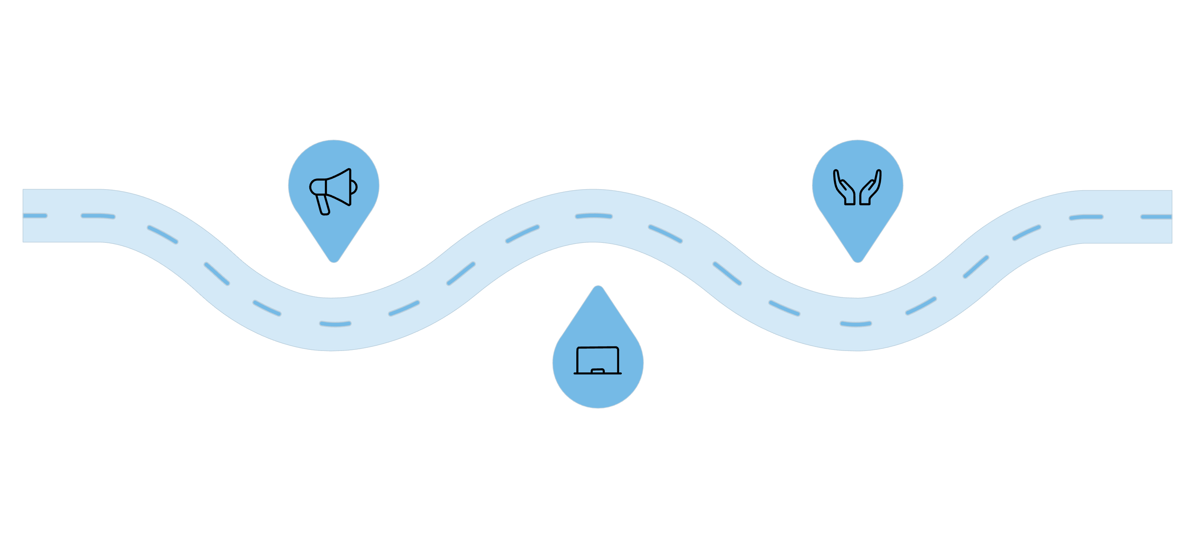
FUHSI Library and Open Science Capacity Building
Building an Open Science culture
Sensitise
Embed
Drive Open Science activities in partnership with LIBSENSE
Integrate practices across units and networks
Train
Workshops on responsible research and commons
The Library is supporting capacity development through Open Science sensitisation programmes, researcher training and workshops, ORCID/PID awareness activities, information literacy programmes, responsible research and scholarly communication training, guidance on Open Access, support for students and early-career researchers, collaboration with university researchers and academic units, engagement with national and international Open Science initiatives, and promotion of responsible research practices.
Our goal: Move Open Science from a concept people have heard about to a practice embedded in everyday research.

Slide 6
Why Health Scientists Must Embrace Open Science
For the Researchers
For the Institution
Increase research visibility
Reach wider audiences
Facilitate collaboration
Increase opportunities for citation
Attract research partnerships
Improve reproducibility
Enhance professional reputation
Discover collaborators and datasets
Accelerate scientific discovery
Increase the potential societal impact of research
Attract grants
Helps with the webometrics ranking of the university.
Stronger research profile
Greater global visibility
More collaboration opportunities
Better dissemination of institutional knowledge
Stronger research culture
Greater public engagement
For the Researcher

Slide 7



What Can Every FUHSI Researcher Do?
Start small, but work smart. Make openness part of your research workflow.
Before Research
During Research
After Research
Use open literature and evidence sources.
Get an Identifier e.g ORCID
Identify appropriate data-management practices e.g identify appropriate storage system for your data to prevent data loss.
Document your methods carefully.
Use responsible and reproducible research practices.
Where appropriate, consider sharing data/code/materials for transparency, openness and integrity.
Publish through appropriate Open Access routes where feasible.
Deposit permitted versions of publications in repositories.
Maintain an accurate ORCID/research profile.
Share research findings beyond the journal article.
Make educational and research materials reusable where appropriate.

Slide 8
Conclusion
Open Science is not simply about opening publications. It is about opening the entire research ecosystem to greater visibility, collaboration, transparency and impact.
Open does not mean careless. Open Science must always respect ethics, privacy, confidentiality, intellectual property and research integrity.
The Library is ready to support this journey.

Slide 9


