Slide 1
Spread the message, educate a woman around you today. 🎀
By Oladele Sekinah

Slide 2
Introduction
Breast cancer is a type of cancer that develops when cells in the breast grow uncontrollably and form a tumor. Breast cancer is the most common cancer globally with around 2.3 million new cases every year. It represents one in eight cancer cases in both sexes and a quarter of all cancers in women with 70% mortality occurring in resource constrained settings. In 2022, breast cancer remained a leading health concern, resulting in an estimated 670,000 fatalities globally, emphasizing the need for continued awareness, research, and early detection efforts.
Sharing awareness about breast cancer is an everyday task to save more lives but the month of October is deeply dedicated to sharing more awareness vigorously on Breast Cancer, so that people can be aware of their risk factors as it will be highlighted in this write up. In fact, it's time to shed light on this disease that affects millions of people worldwide. With early detection and advancement in treatment, survival rates are improving.

Slide 3
Signs & Symptoms

Slide 4
The signs and symptoms of Breast Cancer
The signs and symptoms of breast cancer may include
a lump in the breast,
a change in breast shape,
dimpling of the skin,
milk rejection,
fluid coming from the nipple,
a newly inverted nipple, or
a red or scaly patch of skin.

Slide 5
Risk Factors of Breast Cancer
The followings are the identifiable risk factors for breast cancer:
Being female
Age (mostly over 40 years of age)
Obesity
Genetics and Family history of breast cancer
Lack of exercise
Alcohol consumption
Hormone replacement therapy during menopause
Previous radiation therapy
Early age at first menstruation
Having children late in life or not at all, older age
Previous history of breast cancer
Klinefelter syndrome
Anything that increases the risk of getting a disease is called a risk factor. Having a risk factor does not mean that one will get cancer; not having risk factors doesn’t mean that one will not get it. Talk with your doctor if you think you may be at risk.

Slide 6
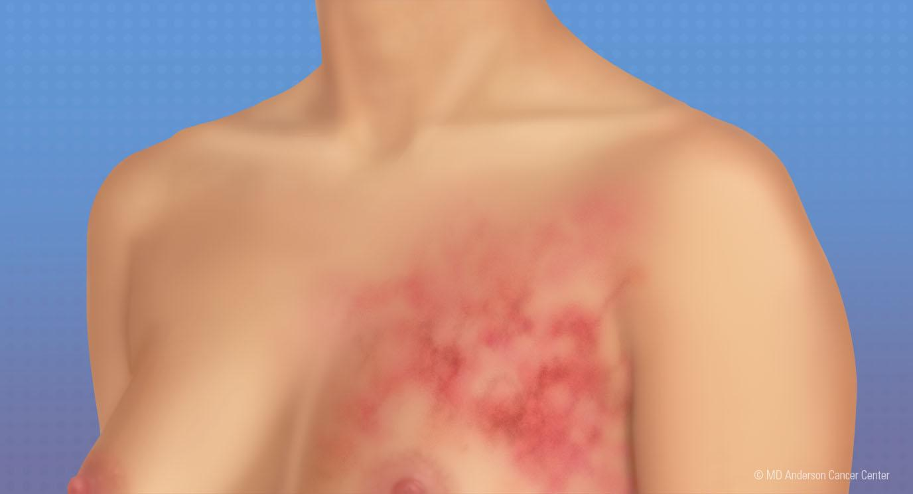
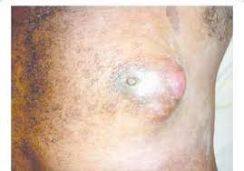
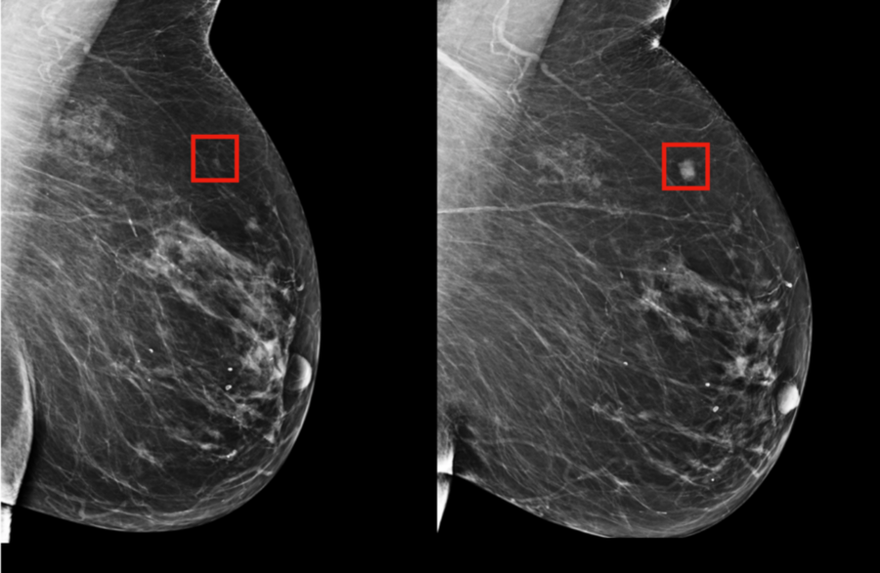

Slide 7
Diagnostic Method of Breast Cancer
Breast Cancer can be diagnosed with any of the following approaches but the most recognized one nowadays is the use of Mammogram.
Tissue biopsy
Mammography,
Ultrasonography

Slide 8
Prevention
Although breast cancer cannot be prevented, the risks of developing breast cancer can be minimized through specific preventive activities. These include achieving changes in:
Screening, Management and Early Detection
Early detection. The most important and beneficial area of protection activities is the early detection of breast cancer (which can be detected through screening). Diagnosis of breast cancer during the early stages of disease has been positively linked to a decrease in the mortality and morbidity of the illness.
There are a number of approaches to the screening of breast cancer. Which are:
Breast self-examination
Clinical breast examination
Mammography
Breast cancer management is determined by the individual's overall health, the molecular profile of the cancer, and the extent of tumor spread at the time of diagnosis.
Management strategies include:
Surgery
Radiation Therapy
Chemotherapy
Hormone Therapy
Targeted Therapy
Immunotherapy
Stem Cell or Bone Marrow Transplant
Precision or Personalized Medicine
Palliative Care
Combination Therapy
lifestyle
diet
breastfeeding
obesity,
Women interventions

Slide 9
Each treatment plan is personalized based on the cancer's characteristics, stage, and patient-specific factors.
Breast Cancer in Men
Risk factors for breast cancer in men may include the following:
Although breast cancer in men only makes up less than 1% of all cases of breast cancer, it is equally important to promote awareness and education among men too, to ensure timely diagnosis and treatment.
Treatment with radiation therapy to your breast/chest.
Having a disease linked to high levels of estrogen in the body, such as cirrhosis (liver disease) or Klinefelter syndrome (a genetic disorder).
Having one or more female relatives who have had breast cancer.
Having mutations (changes) in genes such as BRCA2.
Prognosis
The NCI reports that 90.8%Trusted Source of women with breast cancer survive for 5 years after diagnosis. This survival rate includes all women with breast cancer, regardless of the stage.
A family history of breast cancer and other factors can increase a man's risk of breast cancer.

Slide 10

Thank You
Oladele Sekinah
oladelesekinah@gmail.com
Substack: https://substack.com/@oladelesekinah

